Slide 1

Health Portfolio Brock Reissner – Manager, Health & Research

Slide 2

Notes:
How are we at SOO supporting health and working to improve these statistics...

Slide 3

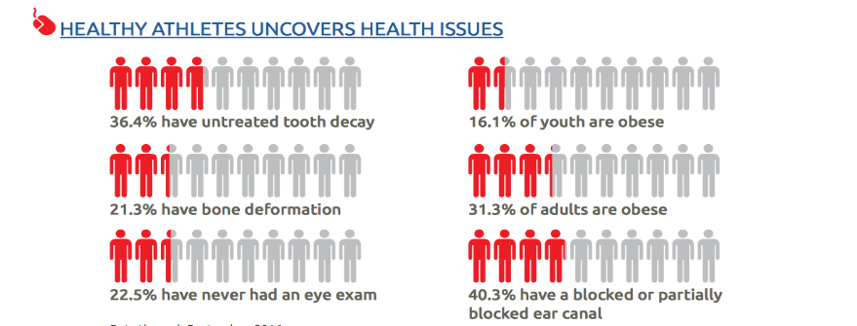
Statistics
In North America, on a team of 10 athletes, on average:
2 have untreated tooth decay and 1 needs an urgent referral to a dentist
4 need eyeglasses and 2 have some kind of eye disease
3 will fail a hearing test
3 will have low bone density
6 will have significant problems with flexibility, and 4 with balance, placing them at risk for injuries
7 will be overweight/obese and at risk for chronic health conditions

Slide 4
Healthy Athletes
Healthy Athletes (HA)
A health screening and education program designed for people with IDD.
HA Screenings are offered in seven disciplines and are administered by volunteer health care providers at local tournaments, competitions and events.
Provide Special Olympics athletes (and non-athletes with an IDD) access to health screenings as well as a chance to identify health needs that often go unexamined or unaddressed.
The Healthy Athletes program has been made possible by the Golisano Foundation, and since its inception, 1.7 million free health examinations have been conducted in more than 130 countries, making Special Olympics the largest health care provider for people with Intellectual Disabilities in the world.

Slide 5







Healthy Athletes Disciplines
Health Promotion
Fit Feet
FUNfitness
MedFest
Special Smiles
Healthy
Hearing
Opening Eyes

Slide 6
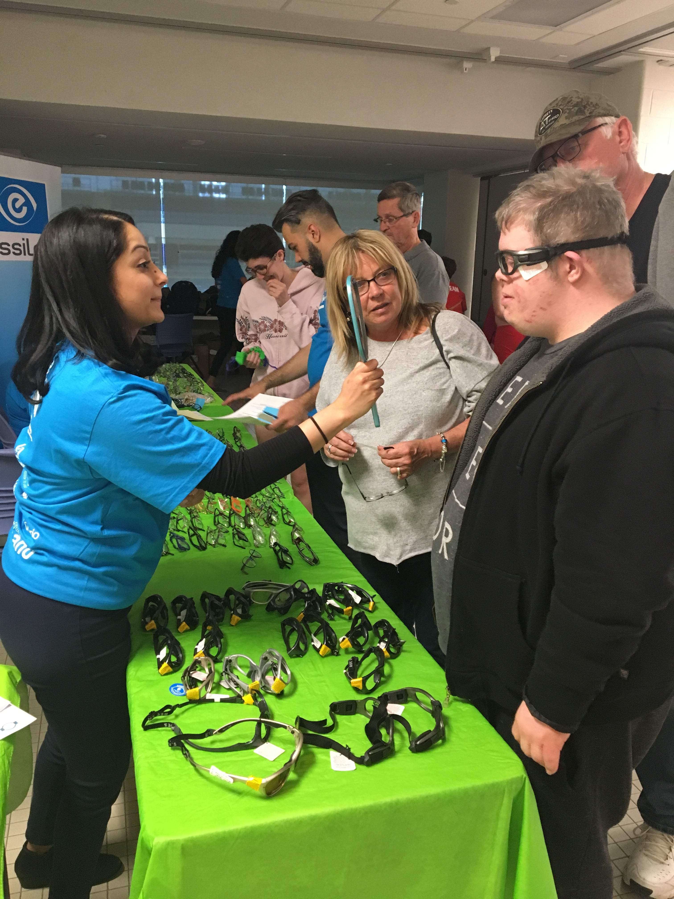
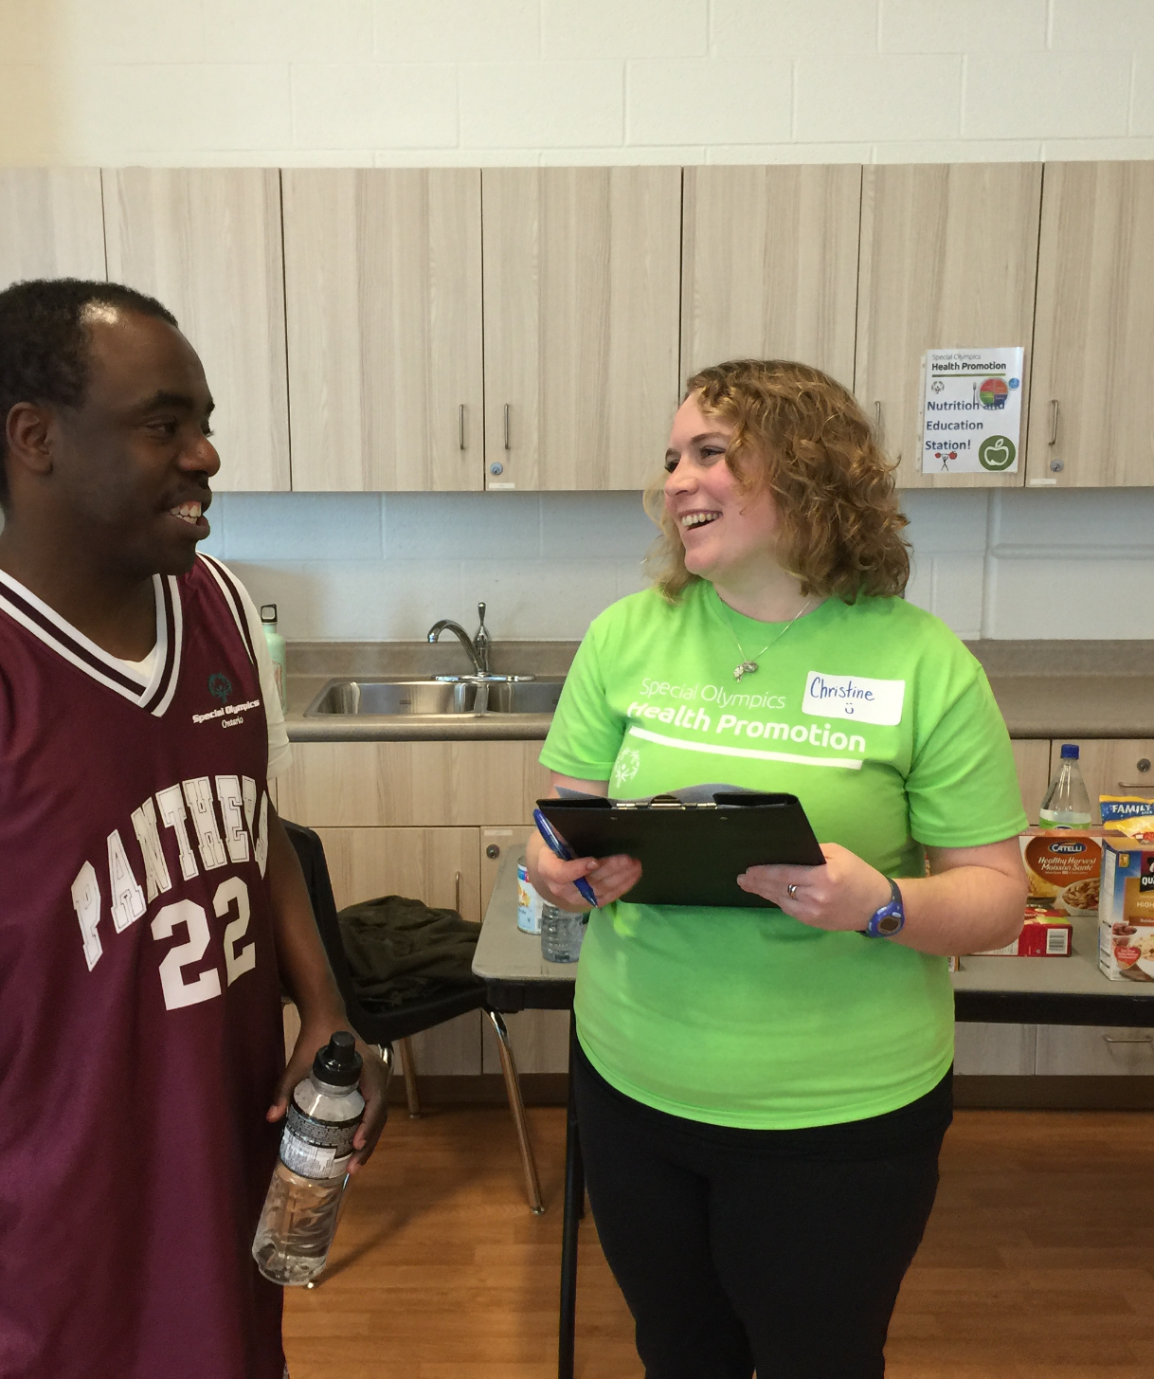
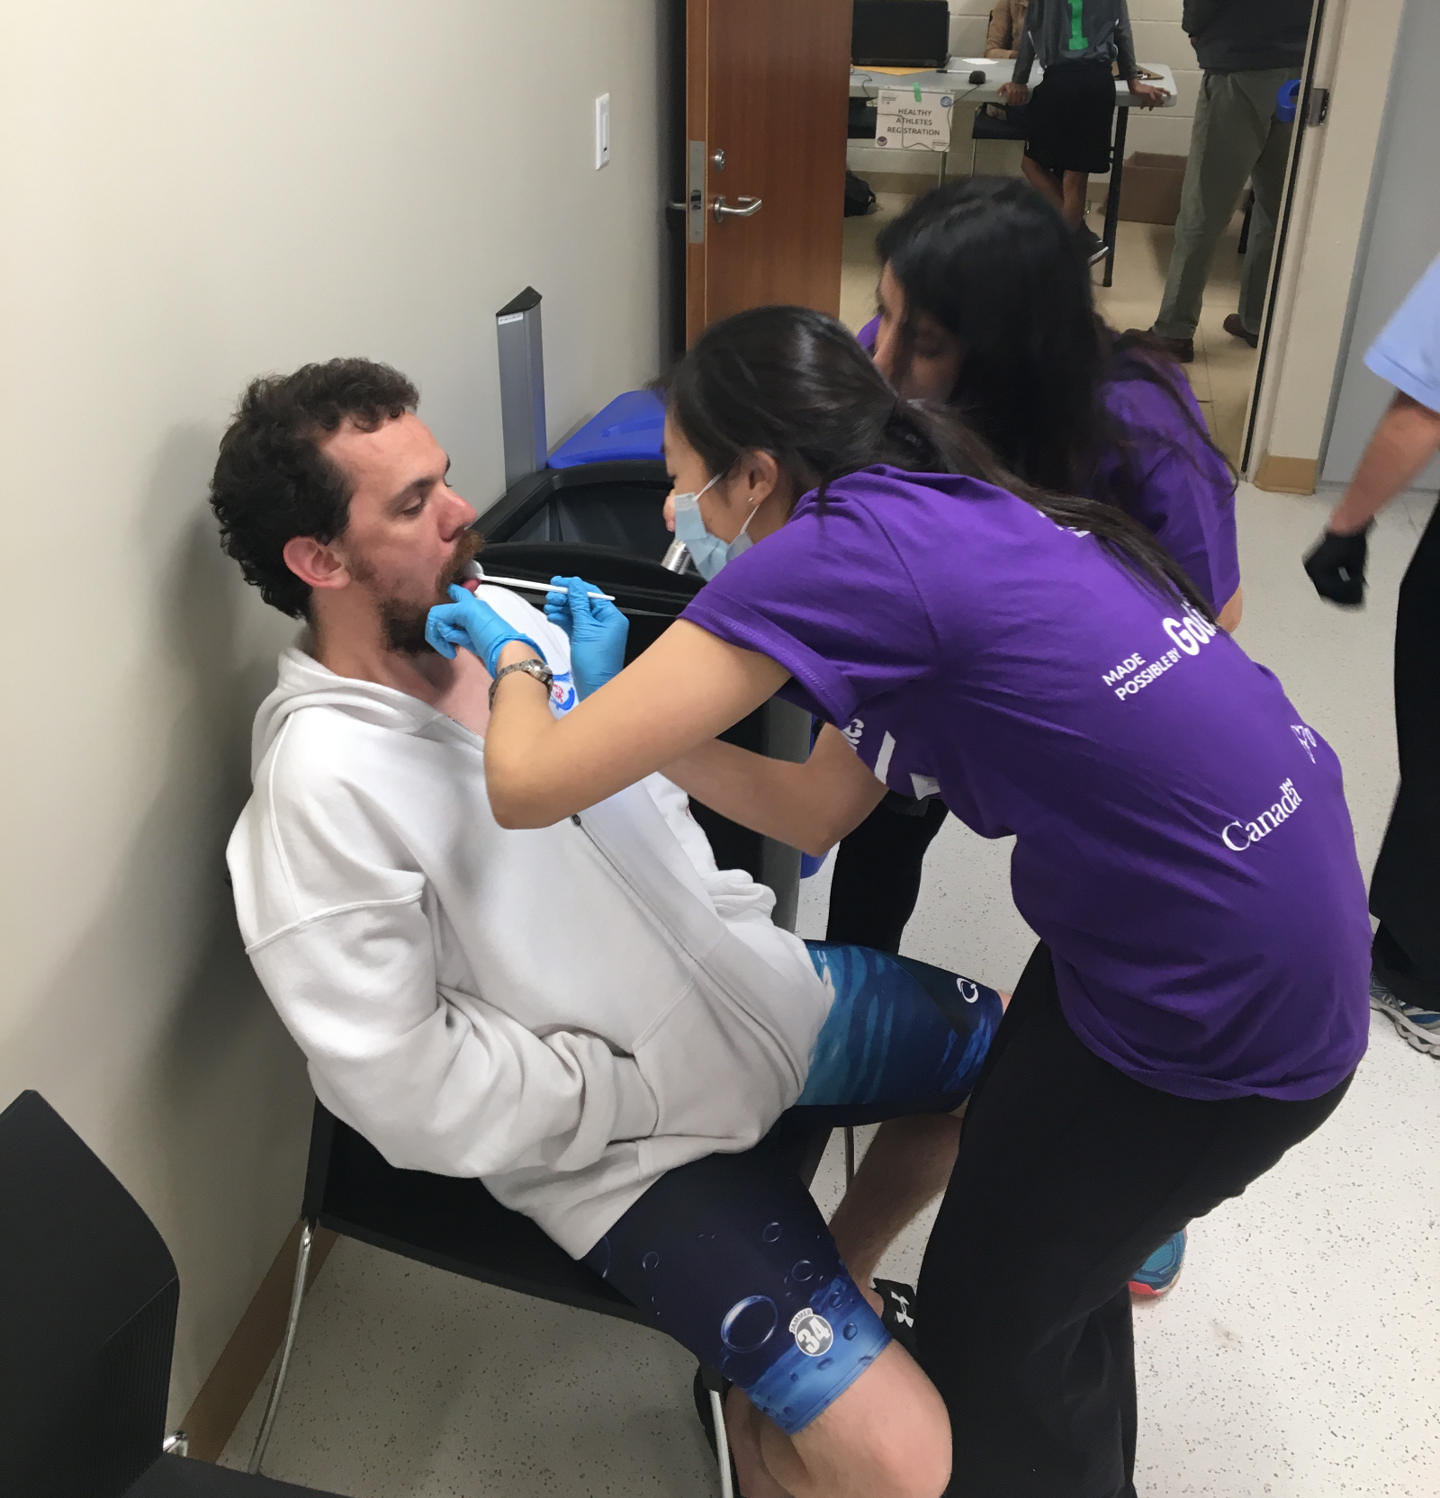
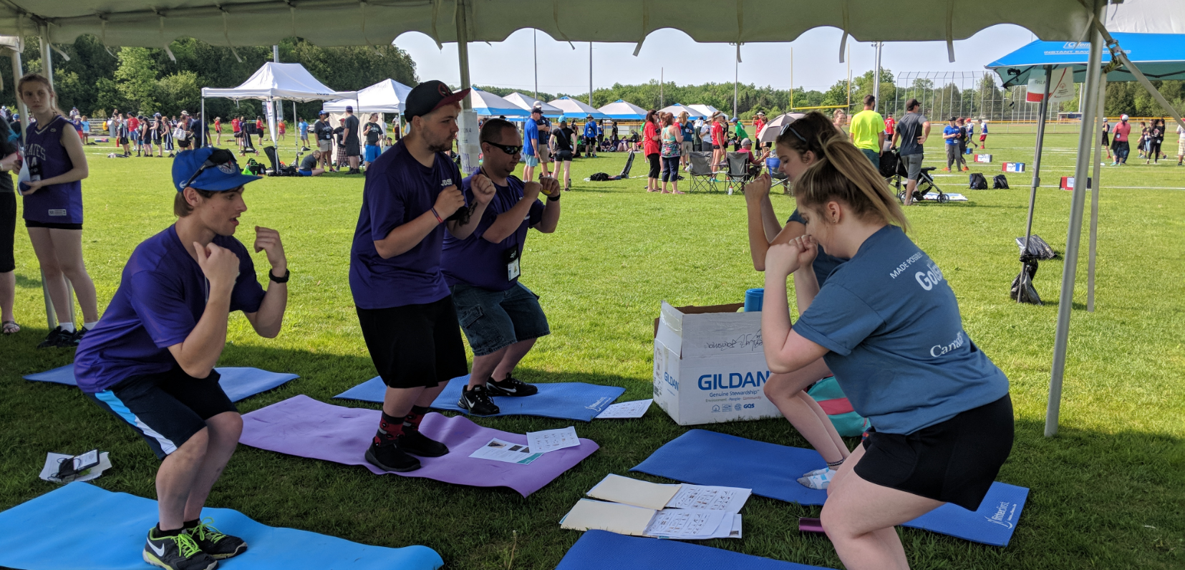
What does a Healthy Athletes event look like?
Health Screening
Health Education
Data Collection
Giveaways
Report Card & Follow-Up Care
What to expect at a Special Olympics Minnesota Healthy Athletes screening

Slide 7
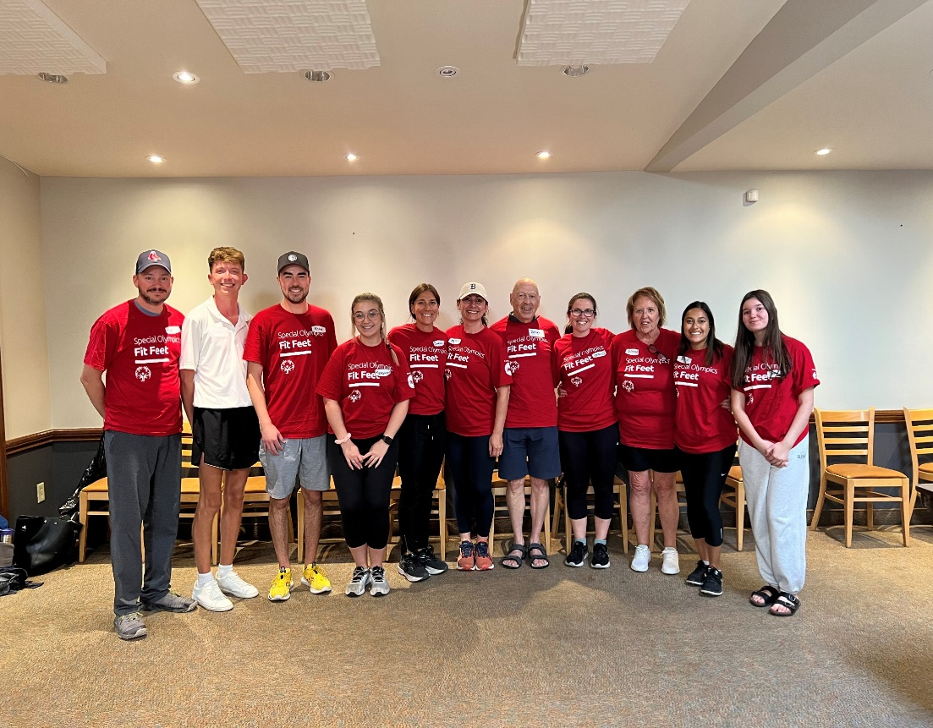
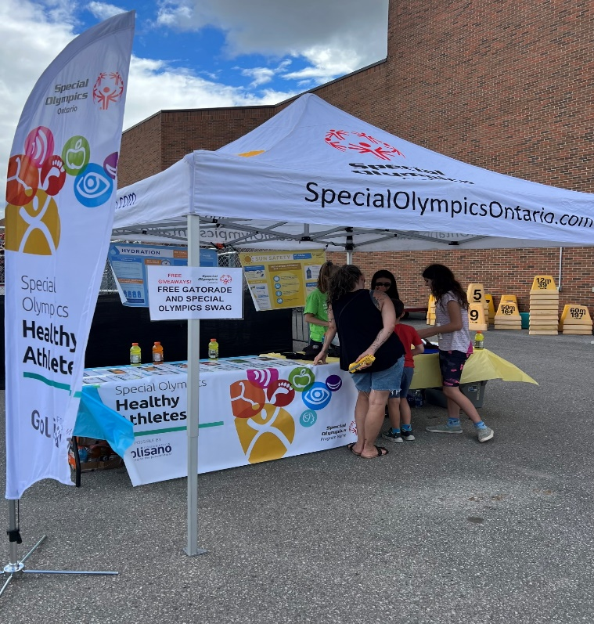
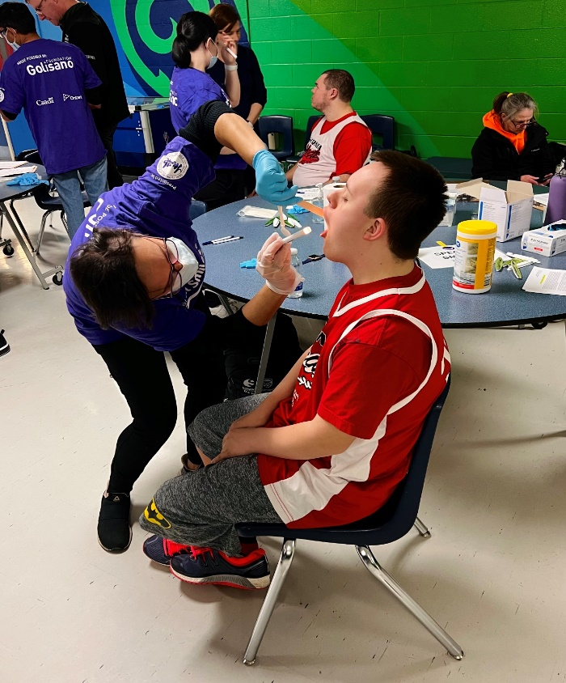
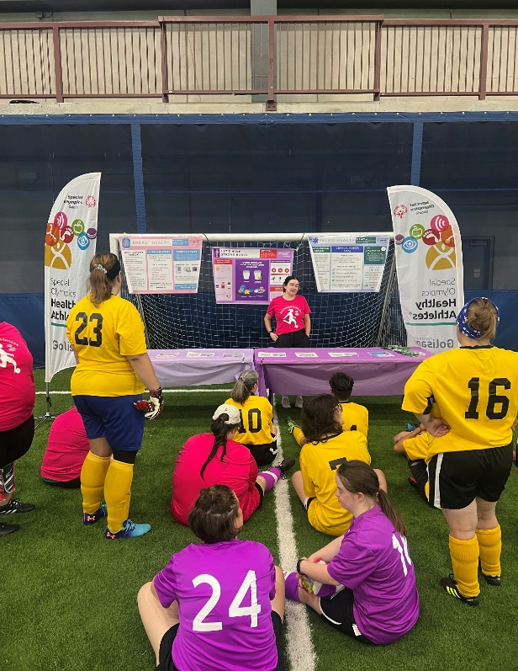
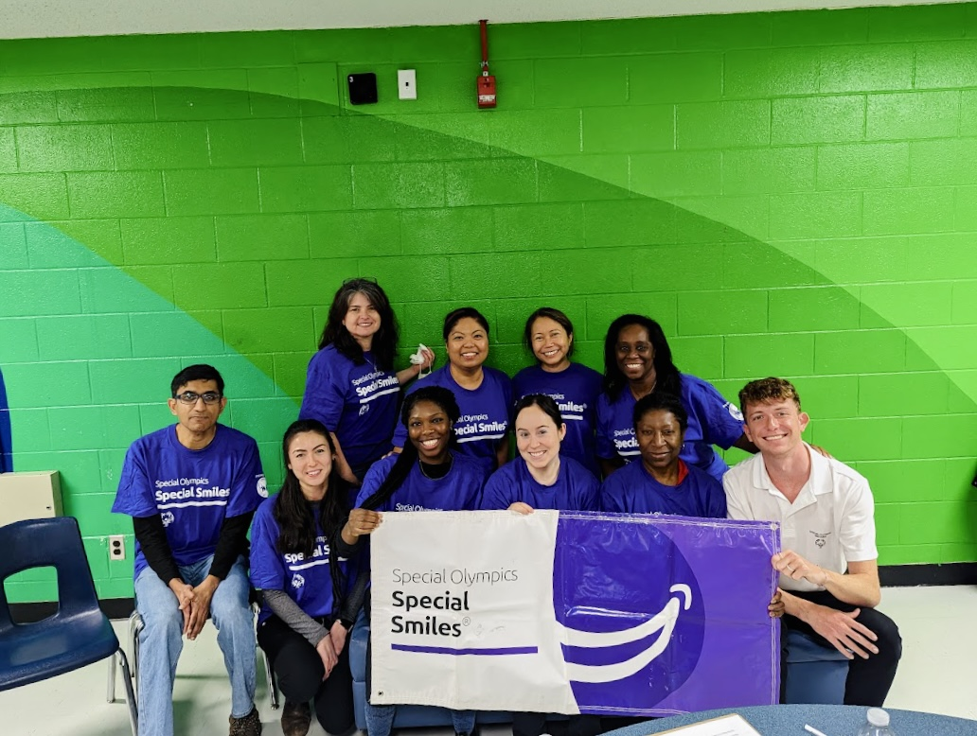
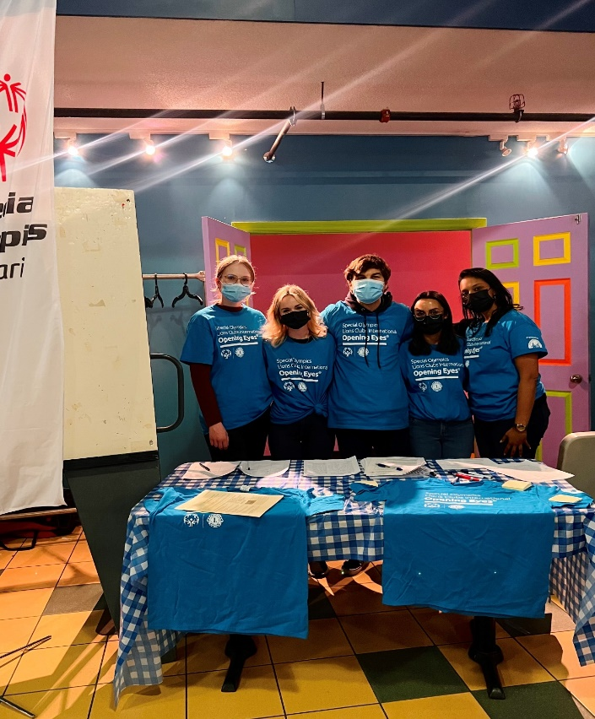
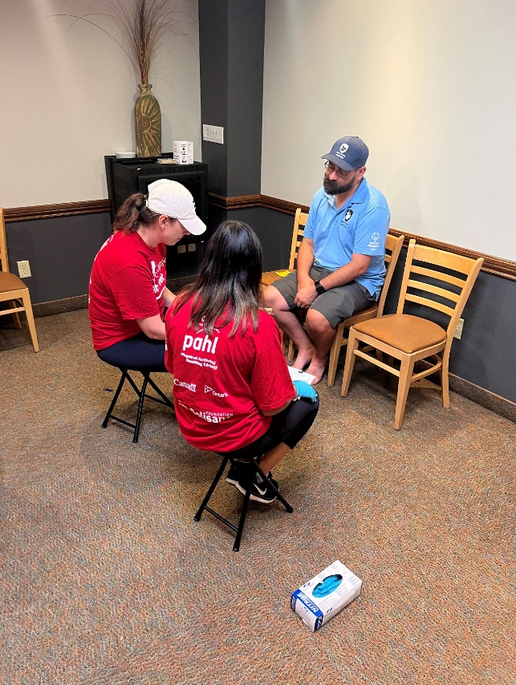
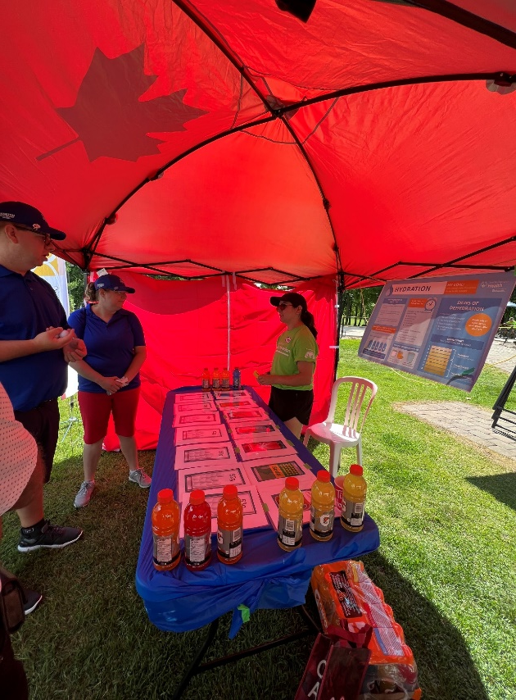

Slide 8
Healthy Athlete Leadership Day
The Healthy Athletes Leadership Day is an exciting opportunity designed specifically for athletes to enhance their physical health, develop leadership skills, and improve overall performance. The day combines health activities, performance-focused activities, and leadership development sessions—all tailored to help athlete’s reach full potential both on and off the field!
Health Education
Comprehensive health education by trained healthcare students.
Performance Stations
Interactive stations focused on enhancing your athletic abilities
Leadership Classes
Workshops to build your confidence and leadership skills.
Topics include public speaking, goal setting, teamwork, and advocacy.
Notes:
Health Education
Comprehensive health education by trained healthcare students.
Personalized health tips and resources to maintain your well-being.
Activities designed to teach athletes about: Physical Activity, Nutrition, Hydration, Stress Management.
Performance Stations
Interactive stations focused on enhancing your athletic abilities.
Activities include flexibility exercises, strength training tips, and endurance challenges.
Learn techniques to improve your overall performance in your sport.
Leadership Classes
Workshops to build your confidence and leadership skills.
Topics include public speaking, goal setting, teamwork, and advocacy.
Opportunities to practice leadership in real-time.
Develop skills that will help you lead both on and off the field.

Slide 9

Discover the SOFitNow Fitness App
The Special Olympics- Fitness App is a free, inclusive fitness tool designed to help students with intellectual and developmental disabilities (IDD) stay active, build healthy habits, and feel empowered in their wellness journey. The app is simple, engaging, and flexible—perfect for use in classrooms, gyms, or at home.
What the app offers:
Easy-to-follow activities for all ability levels
Videos and guides that encourage movement, social connection, and healthy choices
Options for tracking progress and celebrating achievements
Fun challenges to keep students motivated

Slide 10

Provides accessible, guided fitness activities for all ability levels
Builds daily routines that encourage healthy habits
Offers social connection through group activities and challenges
Supports educators with tools to integrate fitness into classrooms
Promotes confidence, independence, and long-term health

Slide 11
Partner in Health (PIH)
The Partner in Health program is one of our solutions for increasing the accessibility of quality healthcare for individuals with IDD across Ontario.
Network of healthcare professionals across Ontario that are trained in providing proper treatment to individuals with IDD
Complete specialized training focused on working with patients with IDD, clinicians are added to our online directory located on the SOO health website
Athletes (or anyone with an IDD) can easily find a healthcare provider in their community who is trained, comfortable having them as a patient, and can provide care tailored to their needs

Slide 12
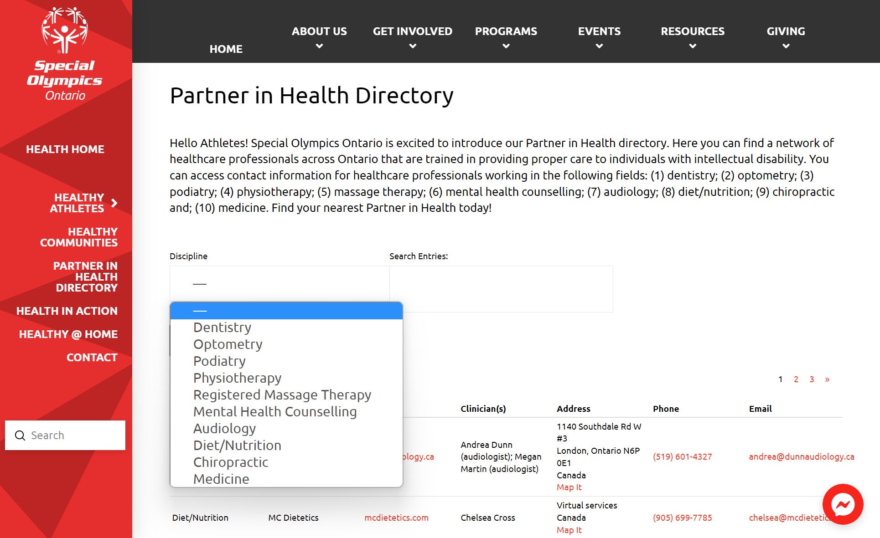
PIH Directory
We currently have 85 healthcare professionals across Ontario and that number continues to grow
https://www1.specialolympicsontario.com/health/partner-in-health-directory/

